Slide 1
Statistical Estimation Theory

Slide 2
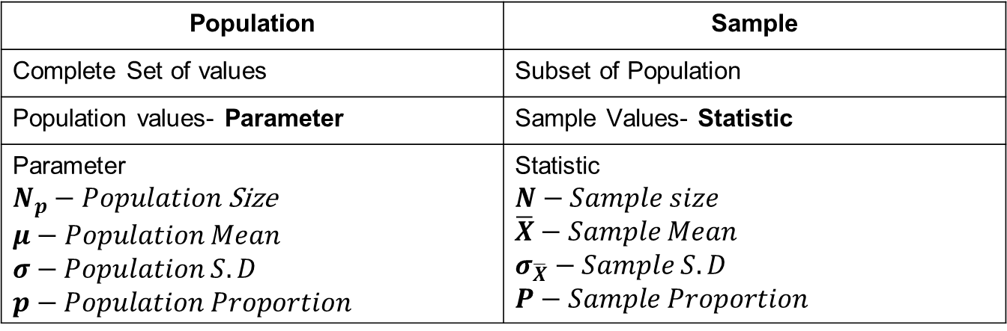
Population Vs Sample
Population | Sample
Complete Set of values | Subset of Population
Population values- Parameter | Sample Values- Statistic
Parameter $N_{p}−Population$ Size $$μ−Population Mean$$ $$σ−Population S.D$$ $$p−Population Proportion$$ | Statistic $$N−Sample size$$ $$\overline{X}−Sample Mean$$ $$σ_{\overline{X}}−Sample S.D$$ $$P−Sample Proportion$$

Slide 3
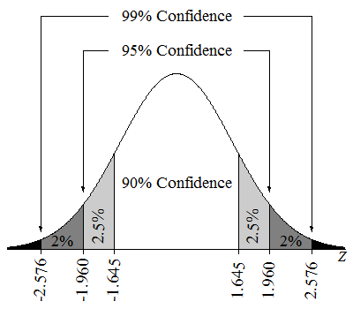
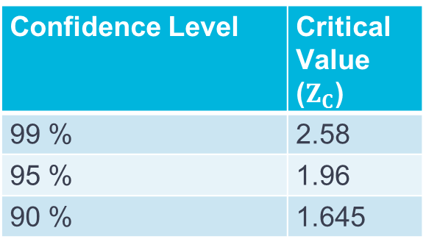
Confidence Intervals
Confidence Level | Critical Value ($Z_{C}$)
99 % | 2.58
95 % | 1.96
90 % | 1.645

Slide 4
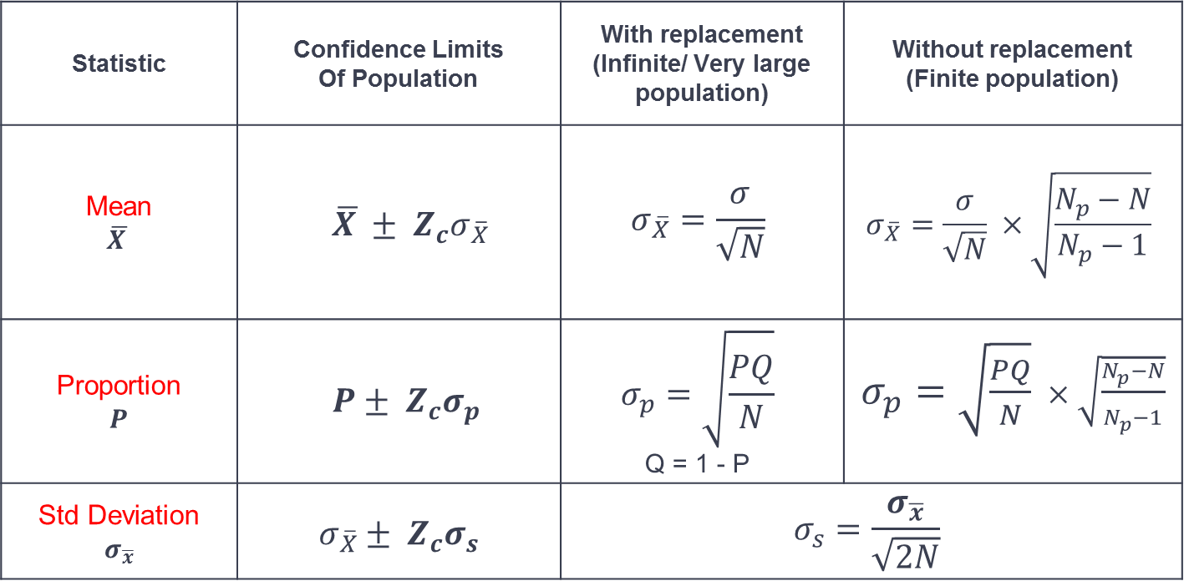
Confidence Intervals
Statistic | Confidence Limits Of Population | With replacement (Infinite/ Very large population) | Without replacement (Finite population)
Mean $$\overline{X }$$ | $$\overline{X }± Z_{c}σ_{\overline{X}}$$ | $$σ_{\overline{X}}=\frac{σ}{\sqrt{N}}$$ | $$σ_{\overline{X}}=\frac{σ}{\sqrt{N}} ×\sqrt{\frac{N_{p}−N}{N_{p}−1}}$$
Proportion $$P$$ | $$P± Z_{c}σ_{p}$$ | $$σ_{p}=\sqrt{\frac{PQ}{N}}$$ Q = 1 - P | $σ_{p}=\sqrt{\frac{PQ}{N}} ×\sqrt{\frac{N_{p}−N}{N_{p}−1}}$
Std Deviation $$σ_{\overline{x}}$$ | $$σ_{\overline{X}}± Z_{c}σ_{s}$$ | $$σ_{s}=\frac{σ_{\overline{x}}}{\sqrt{2N}}$$

Slide 5
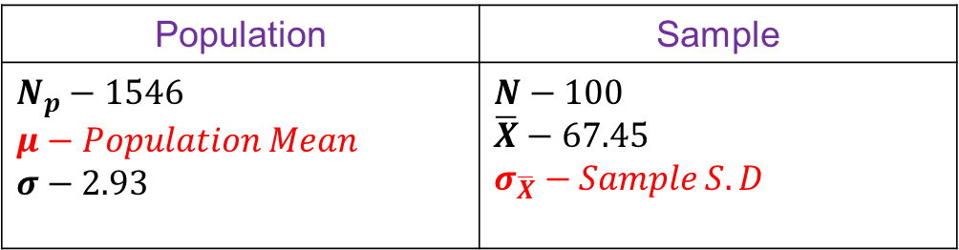
Question
Suppose that height of 100 male students in XYZ university represent a random sample of the heights of all 1546 students in the university with sample mean 𝑋̅=67.45 𝑎𝑛𝑑 𝜎=2.93
Find the (a) 95% and (b) 99% confidence intervals for estimating the mean height.
Solution-
Finite Sampling
Population | Sample
$$N_{p}−1546$$ $$μ−Population Mean$$ $$σ−2.93$$ | $$N−100$$ $$\overline{X}−67.45$$ $$σ_{\overline{X}}−Sample S.D$$

Slide 6
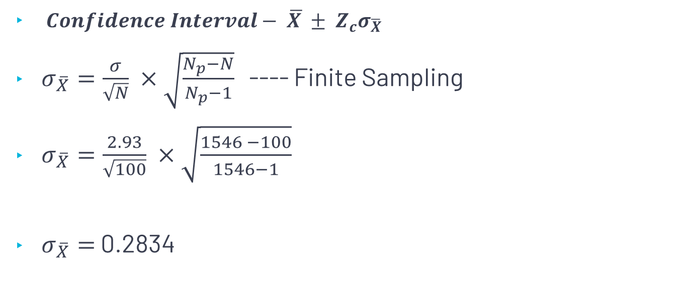
Cont..
$Confidence Interval− \overline{X }± Z_{c}σ_{\overline{X}}$
$σ_{\overline{X}}=\frac{σ}{\sqrt{N}} ×\sqrt{\frac{N_{p}−N}{N_{p}−1}}$ ---- Finite Sampling
$σ_{\overline{X}}=\frac{2.93}{\sqrt{100}} ×\sqrt{\frac{1546 −100}{1546−1}}$
$σ_{\overline{X}}=$ 0.2834

Slide 7
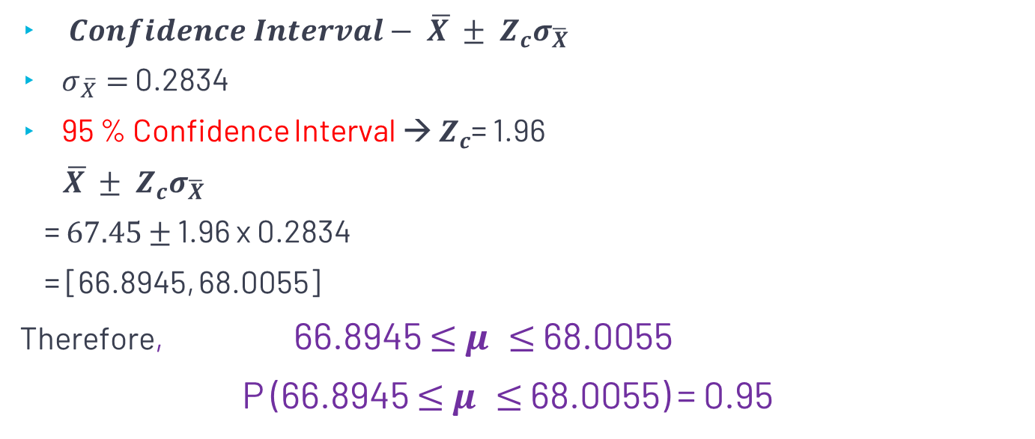
Cont..
$Confidence Interval− \overline{X }± Z_{c}σ_{\overline{X}}$
$σ_{\overline{X}}=$ 0.2834
95 % Confidence Interval → $Z_{c}$= 1.96
$\overline{X }± Z_{c}σ_{\overline{X}}$
= $67.45$ $±$ 1.96 x 0.2834
= [66.8945, 68.0055]
Therefore, 66.8945 $≤$ $μ ≤$ 68.0055
P (66.8945 $≤$ $μ ≤$ 68.0055) = 0.95

Slide 8
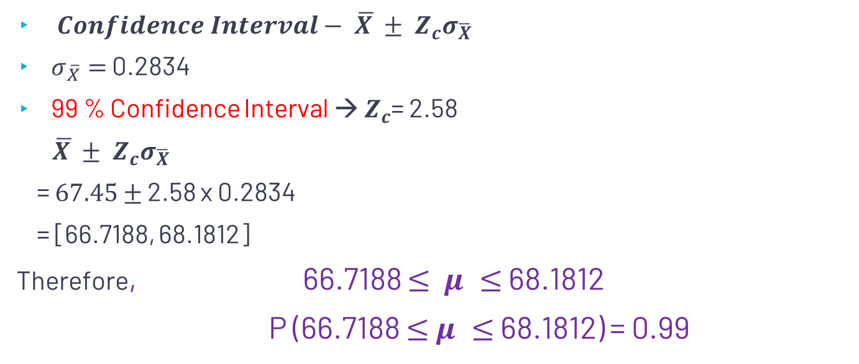
Cont..
$Confidence Interval− \overline{X }± Z_{c}σ_{\overline{X}}$
$σ_{\overline{X}}=$ 0.2834
99 % Confidence Interval → $Z_{c}$= 2.58
$\overline{X }± Z_{c}σ_{\overline{X}}$
= $67.45$ $±$ 2.58 x 0.2834
= [66.7188, 68.1812]
Therefore, 66.7188 $≤$ $μ ≤$ 68.1812
P (66.7188 $≤$ $μ ≤$ 68.1812) = 0.99

Slide 9
Questions
A random sample of 50 mathematics grades out of total 200, showed a mean of 75 and s.d of population is 10. Find 95% and 99% confidence limits for mean of 200 students.
A random sample of 100 articles selected from a batch of 2000 articles shown average diameter 0.354 with s.d. of population is 0.048. Find 90 % and 95% confidence interval for average of the whole batch.

